Slide 1
AI 6: Design a Fuzzy based application using Python.
Durgesh Rajdev Vishwakarma.
MSc IT Part 2 - Sem 3
PRN: 2015430016
VPM's B. N. Bandodkar College of Science, Thane.

Slide 2
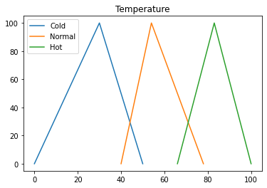
In this example I have used Fuzzy logic to determine Fan Speed based on temperature or city.
In Fuzzy Logic objects are not always in one of two states (true or false), but rather in several states at one time. First, we'll review temperature and fan speed graph to understand need of fuzzy logic in this application.
As you can see in below graph that we are unable to solve this problem with traditional binary logic.
1. Temperature Graph

Slide 3
import matplotlib.pyplot as plt
%matplotlib inline
#temprature
cold = [0, 30, 50]
normal = [40, 54, 78]
hot = [66, 83, 100]
percentage = [0, 100, 0]
plt.plot(cold, percentage)
plt.plot(normal, percentage)
plt.plot(hot, percentage)
plt.legend( ["Cold", "Normal", "Hot"] )
plt.title("Temperature")
plt.show()

Slide 4
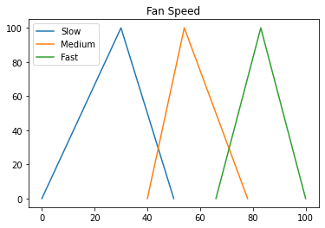
2. Fan Speed Graph
#Fan Speed
slow = [0, 30, 50]
medium = [40, 54, 78]
fast = [66, 83, 100]
percentage = [0, 100, 0]
plt.plot(cold, percentage)
plt.plot(medium, percentage)
plt.plot(fast, percentage)
plt.legend( ["Slow", "Medium", "Fast"] )
plt.title("Fan Speed")
plt.show()

Slide 5
3. Function definition
I have defined below functions in this application:
Membership(x,List): Function determines membership of x in the List.
Is(x,List): Function is used to find whether x is member of List or not.
findSpeed(temp): Function determines fan speed based on temperature.
def Membership(x,List):
"Returns the membership of a value in a list."
top=(float(x)-List[0])
bottom=(List[-1]-List[0])
M= top/bottom
return M
#print( "Membership: " + str(M) )
def Is(x,List):
"Returns true if a value is in the value range of a list"
#If a value is greater than the first item in a list..
if x >= List[0]:

Slide 6
#And if it is smaller than the last item in the list...
if x<= List[-1]:
#print the membership of the item in the list...
Membership(x,List)
#And return True
return "Yes"
#No else statement is needed since the return statement will exit the function.
#Print the membership and return False if the above condition is false.
Membership(x,List)
return "No"
#Determine Fan speed based on temperature
def findSpeed(temp):
"Determine Fan Speed based temperature or city"
temp_cold = Membership(temp, cold)
temp_medium = Membership(temp, normal)
temp_hot = Membership(temp, hot)

Slide 7
#Fuzzy logic values lies between 0 & 1 (if membership is less than 0 then make it 2 & filter them)
if temp_hot < 0:
temp_hot = 2
if temp_medium < 0:
temp_medium = 2
if temp_cold < 0:
temp_cold = 2
if( temp_cold <= temp_medium):
return "Slow"
elif( temp_medium <= temp_hot):
return "Medium"
else:
return "Fast“

Slide 8
def document(f):
#Print the name of a function and its document string.
print( f.__name__ +': '+ f.__doc__+'\n’ )
# Function Documentation
document(Is)
document(Membership)
document(findSpeed)
Output:
Is: Returns true if a value is in the value range of a list Membership: Returns the membership of a value in a list. findSpeed: Determine Fan Speed based temperature or city

Slide 9
4. Variable declaration
I have defined a range of temperature of cold, normal and hot as below, which we'll use to determine whether given temperature is cold, normal or hot.
Based on which we'll take next action (decide fan speed: slow, normal or fast).
#temprature range
cold = (0, 50)
normal = (40, 78)
hot = (66, 100)
# Average temperature of cities
Mumbai = 88
Pune = 64
Shimla = 17
Jaipur = 90

Slide 10
5. Verify function with sample cities
Here we'll verify functionality of Is() function before combining it with findSpeed() function.
As you can see application is able to determine cold, normal or hot based given temperature.
print( "Is Shimla cold: " + str( Is(Shimla, cold) ))
print( "Is Shimla normal: " + str( Is(Shimla, normal) ))
print( "Is Shimla hot: " + str( Is(Shimla, hot) ))
Output:
Is Shimla cold: Yes Is Shimla normal: No Is Shimla hot: No

Slide 11
print( "Is Pune cold: " + str( Is(Pune, cold) ))
print( "Is Pune normal: " + str( Is(Pune, normal) ))
print( "Is Pune hot: " + str( Is(Pune, hot) ))
Output:
print( "Is Mumbai cold: " + str( Is(Mumbai, cold) ))
print( "Is Mumbai normal: " + str( Is(Mumbai, normal) ))
print( "Is Mumbai hot: " + str( Is(Mumbai, hot) ))
Output:
Is Pune cold: No Is Pune normal: Yes Is Pune hot: No
Is Mumbai cold: No Is Mumbai normal: No Is Mumbai hot: Yes

Slide 12
6. Verify Fuzzy Logic with city & temperature
I have used 3 different cities and temperatures values to verify our application which we have created using Fuzzy logic.
print("Fan speed for Shimla: " + str( findSpeed(Shimla) ) )
print("Fan speed for Pune: " + str( findSpeed(Pune) ) )
print("Fan speed for Jaipur: " + str( findSpeed(Jaipur) ) ) Output:
print("\n")
print("Fan speed at 20: " + str( findSpeed(20) ) )
print("Fan speed at 60: " + str( findSpeed(60) ) )
print("Fan speed at 90: " + str( findSpeed(90) ) )
Fan speed for Shimla: Slow Fan speed for Pune: Medium Fan speed for Jaipur: Fast Fan speed at 20: Slow Fan speed at 60: Medium Fan speed at 90: Fast

Slide 13
Thank You!! ☺
We have successfully designed a Fuzzy based application using Python.
For more details, please review document of this.

